Slide 1
Fundamentals of ETL Testing
Day -2

Slide 2
Agenda
ETL Layers
Source to Stage Layer Validations
Stage to Base Layer Validations
Types of validations
Sample Query Check
Transformation Types
Validation Approaches
Q & A

Slide 3
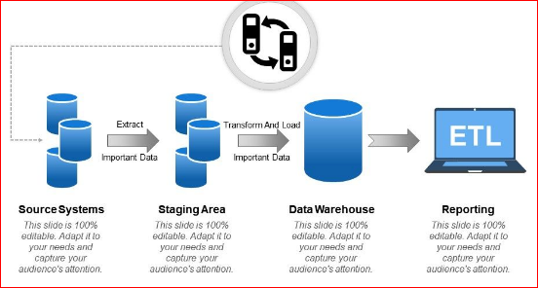
Standard ETL Layer
to create the data , but back-end applications (like Oracle, DB2, Teradata, IBM DB2, Mongo DB, Cassandra, Couch DB, Azure DB, Green DB) used to store the data which created by Front End applications. “

Slide 4
Source to Stage Validations
Primary Validations
DDL Validation
Count validation
Data Validation
Example
Source table = 100 Rec , Target table = 100 Rec
Validations | Description
DDL Validation | To validate all the column is created with proper data type as per mapping spec
Count Validation | Need to check the source table count is matched with Target table count
Data Validation | To verify all the records are properly migrated from Source to Target

Slide 5
Stage to Base Validations
Primary Validations
DDL Validation
Count validation
Data Validation
Duplicate validation
Mandatory column check
BVA check
Example
Source table = 100 Rec ,
Target table = 100 Rec
Validations | Description
DDL Check | To validate all the column is created with proper data type as per mapping spec
Count Check | Need to check the source table count is matched with Target table count
Data Check | To verify all the records are properly migrated from Source to Target
Mandatory Column check | To ensure all mandatory columns are populated with legitimate values
Duplicate check | To verify target table is not loaded with any duplicates
BVA Check | Boundary Value Analysis , Kind of Negative Testing.

Slide 6
Query Validations
Count Check
Select count(*), ‘EMP_DETAIL’ from Emp_detail
union all
Select count(*),’Employee’ from Employee;
Duplicate Check
Select EmployeeNumber , count(*) from Employee
group by EmployeeNumber
having count(*) > 1;
Minus Query
Select concat(Emp_detail.first_name,Emp_detail.Last_name) as FullName,
Emp_detail.Emp_no as EmployeeNumber, Emp_detail.Sal as Salary , Emp_detail.Dept from Emp_detail
Minus
Select FullName, EmployeeNumber, Salary, Department from Employee;

Slide 7
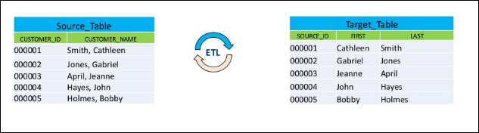
Transformation Types
1) Field Splitting
Splitting a single column into multiple column values in the target table.

Slide 8
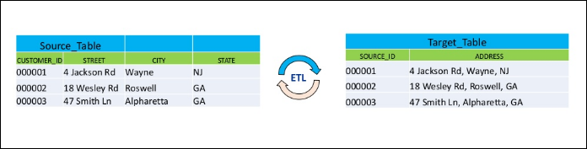
Transformation Types
2) Field Merging
Combine multiple source fields into a single field in the target tale.

Slide 9
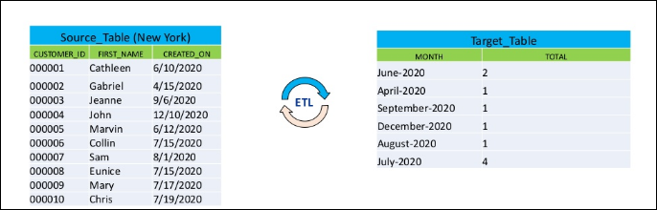
Transformation Types
3) Calculated & Derived Fields
Target column is populated with transformation values as per mapping requirement .

Slide 10
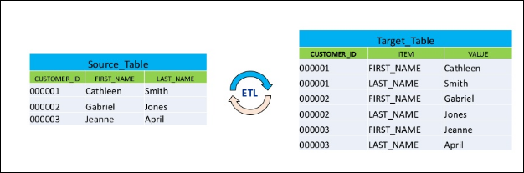
Transformation Types
4) Transpose
Convert columns into row or vice versa.

Slide 11
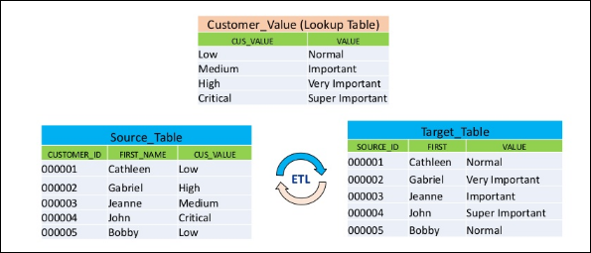
Transformation Types
5) Lookups
Target column will be populated based on Reference (or) Look up tables

Slide 12
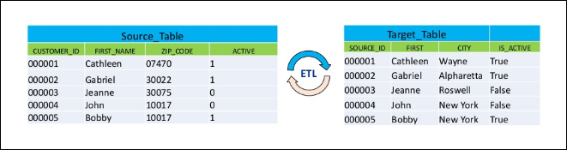
Transformation Types
6) Translation
Translating coded values to their actual values

Slide 13
Validation Approaches
File to File Validation
File to Table Validation
Table to File Validation
Table to Table Validation (Homogeneous Environment)
Table to Table Validation (Heterogeneous Environment)
Homogeneous Environment
source & target table exists in the same application called Homogeneous Environment
Heterogeneous Environment
source & target table exists in the different application called Heterogeneous Environment

Slide 14


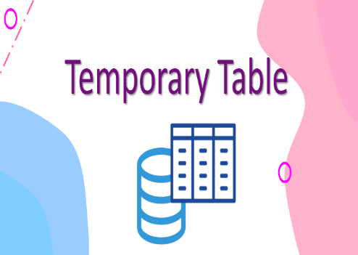
Heterogeneous Environment Validations
Query Surge Automation | Unix Shell Script Automation | Temp Table Approach
Optimization Full Load SQL Query is Required | Shell scripting is required | Need to Load .CSV file by using data loader Utility in My SQL
One time Activity | Changes May (or) May not required | One time -Table creation activity & Frequent Data Load is required
Full Load Data Validation Process | Full Load Data Validation Process | Full Load Data Validation Process but limitations are there
Query Surge Framework skillset is required | Strong Unix Scrpting knowledge is required | Automation knowledge doesn’t require
Commercial & expensive | Open source | Open source
Best solution and easy to implement for heterogeneous validation | Best solution when it comes to open-source platform | Full load optimization minus query is required
Good approach for Regression Testing | Good Solution for Regression & E2E Testing but it is bit difficult to preprae the framework | Best solution for SIT & Regression testing when we don’t any data comparator tool.
Dependency require | Dependency Require | Doesn't Require dependency

Slide 15
Q & A

